Slide 1
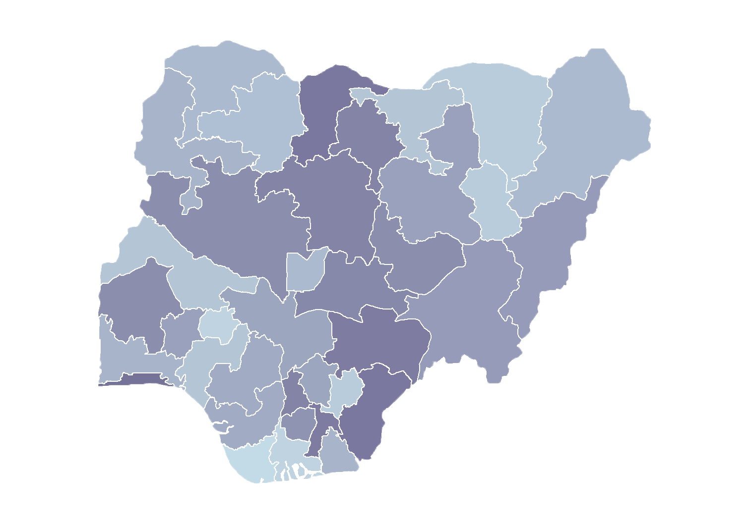
Module 2.1
Facilities Management
Rollout of Health Facility Registry/Master Facility List for States and Local Government Areas in Nigeria
June 2019

Slide 2
Outline
Creating a facility record
Updating facility records
Deleting facility records
Tracking submitted requests

Slide 3
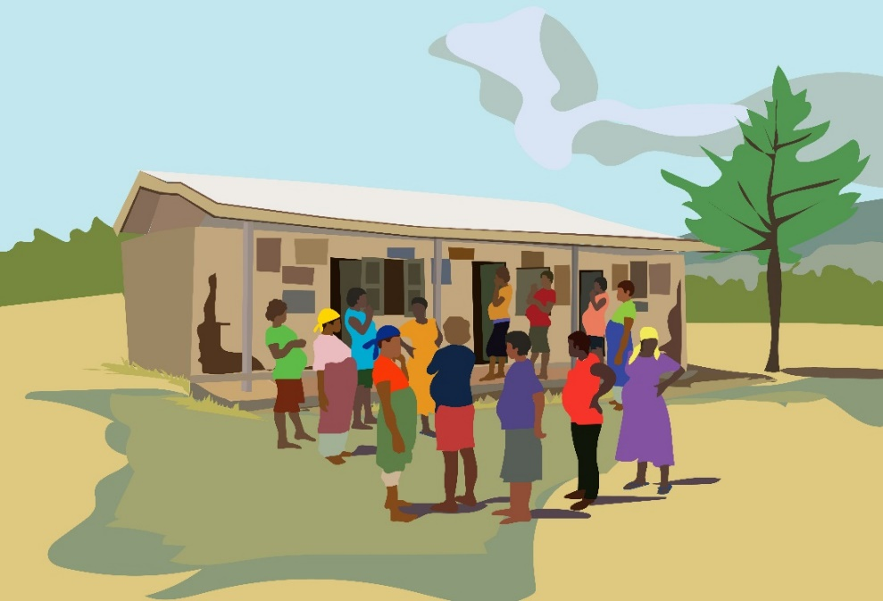
Create a facility record

Slide 4
Create a facility record
Facility record creation in a Health Facility Registry (HFR) is done after the paper-based registration process is completed.
Any person with a data entry role can create a new facility in an HFR.
Data entry can be done at the local government area (LGA) or state level.
For a facility to be visible to the public, it must be approved by following standard operating procedures.

Slide 5
Create a facility
Data entry
Log in to the HFR curation module
Click the Hospitals and Clinics menu. The list of all hospitals in your assigned state will be shown.
Click on
A new data entry form will be opened.

Slide 6
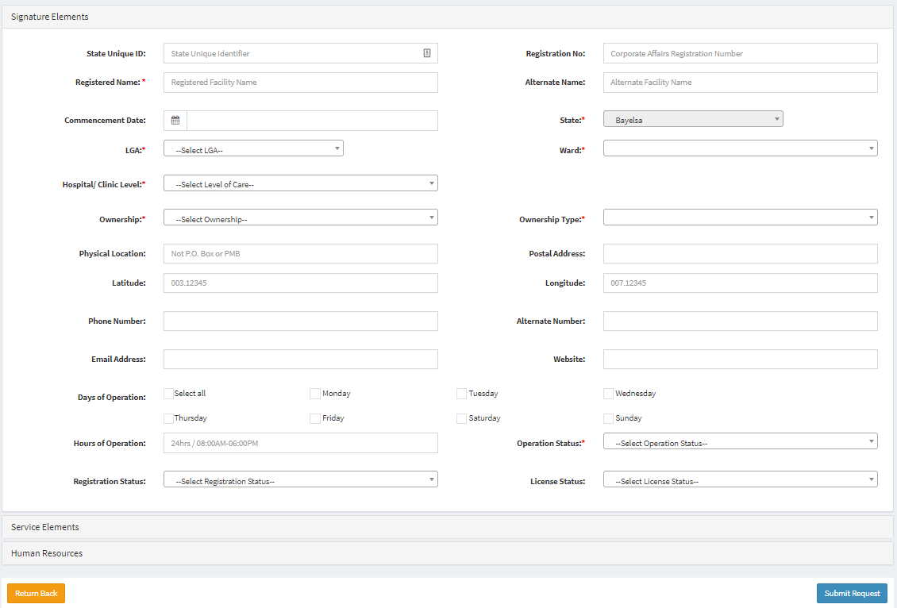
Create a facility record
Data entry form

Slide 7
Create a facility record
Data entry form
The data entry form has 3 tabs:
Signature domain
Service domain
Human resources
Complete the form with information from the Hospital and Clinics Data Collection Form.
All fields marked * are mandatory.
After completing the form, click

Slide 8
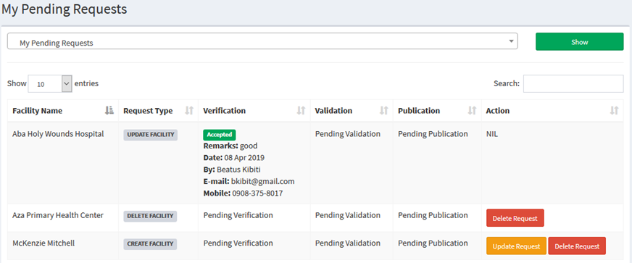
My requests
Once the request is submitted, notification will be sent to verifiers to review the facility.
To track the status of your request, go to the My Pending Requests menu.

Slide 9
My requests
Request status
You can view your requests by their status.
My Pending Requests: All of your requests that have not yet been published
My Rejected Requests: All of your requests that have been rejected at any stage of approval
My Approved Requests: All of your requests that have been published

Slide 10
My requests
Updating and deleting a request
You can update or delete your own request if it has not been verified.
You can also update your request if it has been rejected by a verifier.

Slide 11
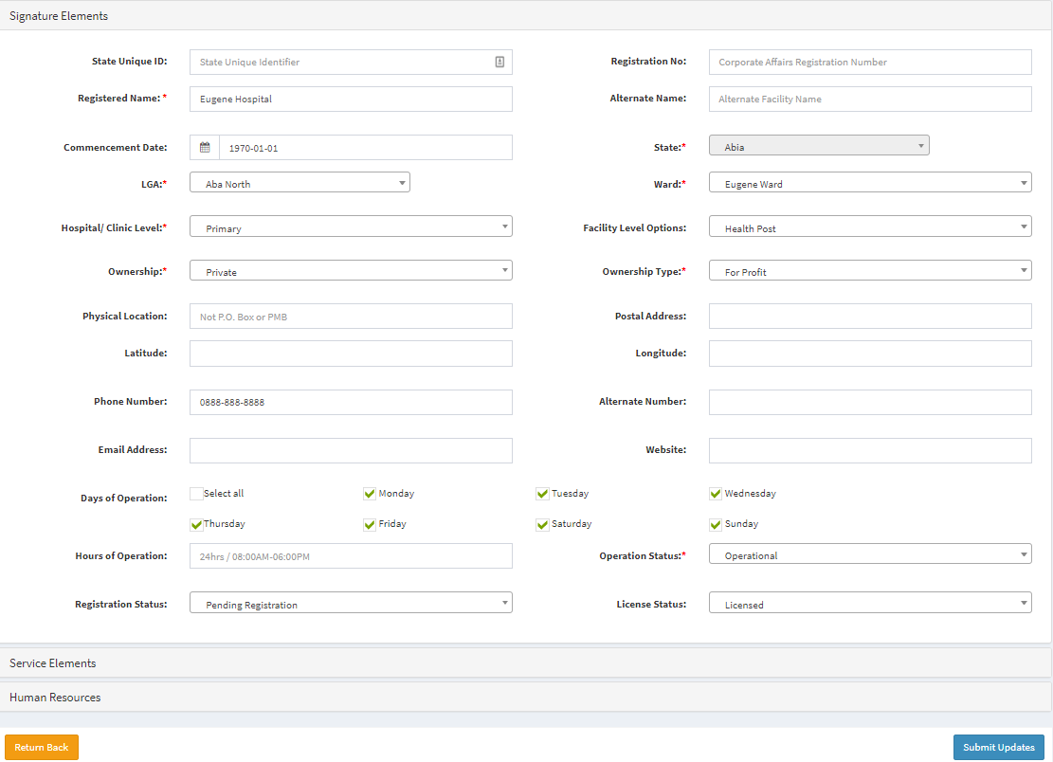
My requests
Updating a request
To update, click Update Request.
A form to update facility details will open.
Update details as required.
Then click Submit Update.

Slide 12
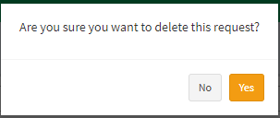
My requests
Delete request
To delete, click Delete Request. This will show the form to confirm the deletion:
Click Yes to delete the request or No to cancel the deletion.

Slide 13
Demonstration

Slide 14
Activity

Slide 15
Practice
Create a facility record
Choose 3 completed forms for new facility records from your LGA.
Create and submit the request for approval.
Go to My Pending Requests and observe their current status.
You have 15 minutes to complete the task.

Slide 16
Update facility

Slide 17
Updating a facility
Discussion
Do you think there will be a need to update facility information? If yes, why do you think we will need to do this?
What may make it necessary to change facility information?

Slide 18
Updating a facility record
Facility details may change for many reasons. Examples:
The facility have been downgraded (e.g., from secondary to primary).
The facility may have been upgraded.
Facility information may be wrong (e.g., it may have been placed in the wrong ward).
The services offered may have changed.
The license or operation status may have changed.

Slide 19
Updating a facility record
To keep the Master Facility List current and accurate, facility information needs to be updated as changes occur.
Facility updates can be initiated by any user (data entry, verifier, validator, publisher).
The update will undergo approval following standard operating procedures before the updates take effect and become visible to the public.

Slide 20
Updating a facility record
Log in to the HFR.
Click the Hospitals and Clinics menu. The list of all hospitals in your assigned state will be shown.
Search for the facility you need.
Click Edit to open the facility update form.

Slide 21
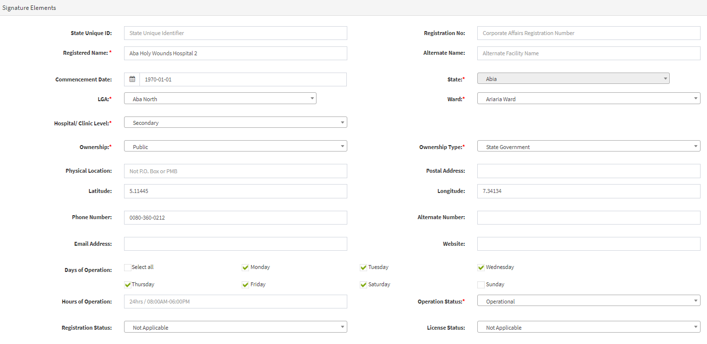
Updating a facility record
Update the facility form

Slide 22
Updating a facility record
The facility update form is like the data entry form.
Update all changed information and click Submit update request.
The same approval process is required as the one for creating a facility.
You can track your submitted request in the My Pending Requests menu.

Slide 23
Demonstration

Slide 24
Activity

Slide 25
Practice
Updating a facility record
Choose any facility in your state or LGA.
Update the facility as follows:
Facility name: your full name
Commencement date: today’s date
Phone number: your mobile number
Email: your email address
Website: HFR training server URL
Services: all dental services
Submit the request.

Slide 26
Deleting a facility

Slide 27
Deleting a facility record
Deleting a facility record in the HFR means completely removing a facility record.
The record can be deleted only under the following conditions:
The facility’s record is confirmed to be a duplicate.
The facility does not exist in a state or LGA.
Only users with a deletion role assigned will be able to initiate facility deletion.

Slide 28
Deleting a facility record
Log in to the HFR.
Click the Hospitals and Clinics menu. The list of all hospitals in your assigned state will be shown.
Search for the facility you want.
Click Delete.

Slide 29
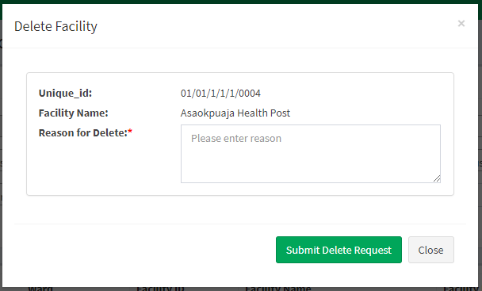
Deleting a facility record
You will get the following form:
Enter the reasons to delete the facility.
Click Submit Delete Request.

Slide 30
Deleting a facility record
The deletion request will be sent to a verifier for review.
The facility will not be deleted immediately.
The request must go through all approval levels.
Once the publisher accepts the deletion, the facility will be deleted.

Slide 31
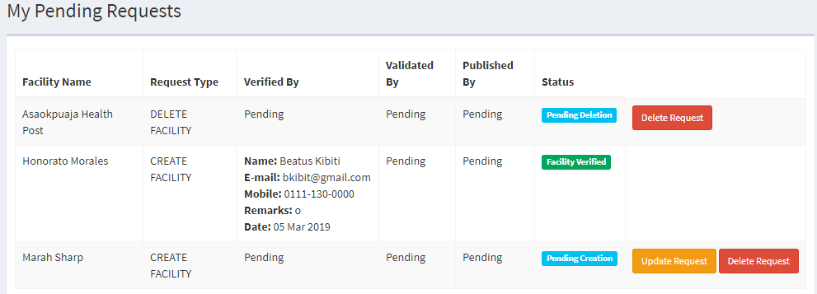
Deleting a facility record
You can track your submitted request in the My Pending Requests menu, as shown earlier.

Slide 32
Demonstration

Slide 33
Activity

Slide 34
Practice
Deleting a facility record
Choose any facility in your state or LGA.
Submit a delete request with details explaining why you want to delete the facility.

